Slide 1

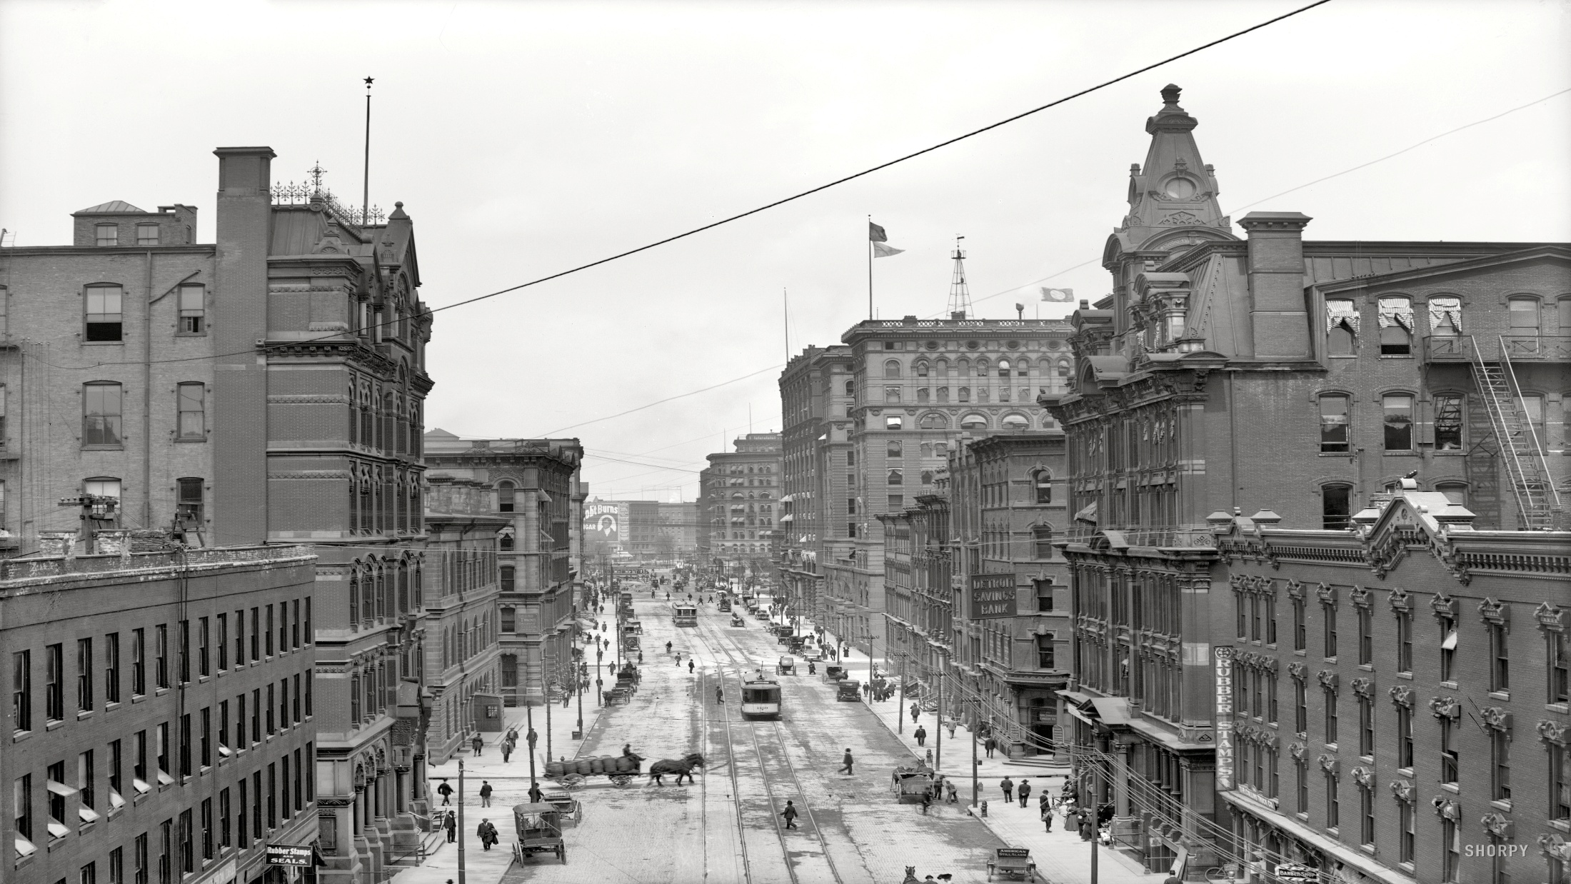
SUBTITLE

Slide 2
PART 1
ADD YOUR TITLE
PART 2
ADD YOUR TITLE
PART 3
ADD YOUR TITLE
CONTENT
PART 4
ADD YOUR TITLE
PART 5
ADD YOUR TITLE

Slide 3

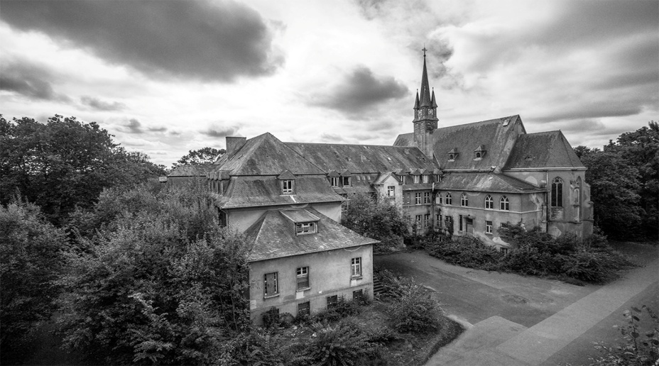

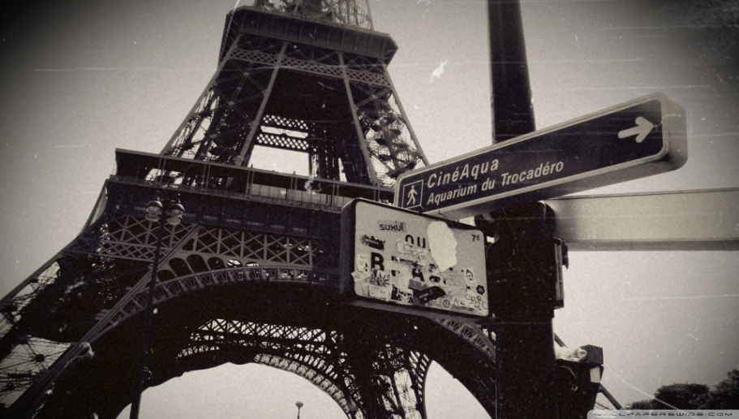
1
CONTENT 1
Memories flashed across my mind as I came across the
first photo of myself as a little baby. Nostalgia took me
to the depths of past.

Slide 4
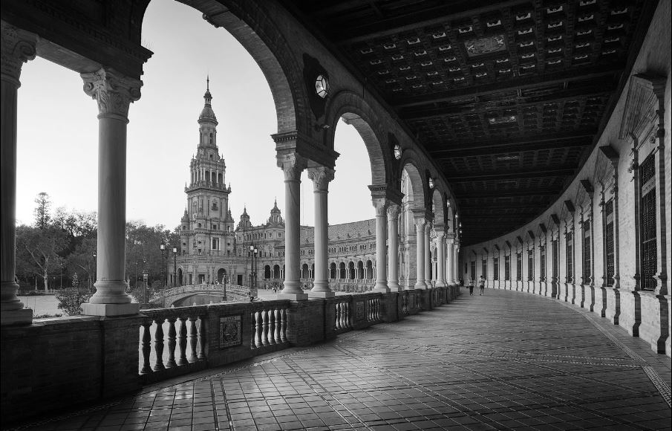
TITLE
ADD YOUR TITLE
ADD YOUR TITLE
ADD YOUR TITLE
Memories flashed across my mind as I came a
cross the first photo of myself as a little baby.
Nostalgia took me to the depths of past.
Memories flashed across my mind as I came a
cross the first photo of myself as a little baby.
Nostalgia took me to the depths of past.
Memories flashed across my mind as I came a
cross the first photo of myself as a little baby.
Nostalgia took me to the depths of past.

Slide 5

ADD YOUR TITLE
ADD YOUR TITLE
Memories flashed across my mind as I
came across the first photo of myself as
a little baby. Nostalgia took me to the
depths of past.
2016
2017
2018
2019

Slide 6
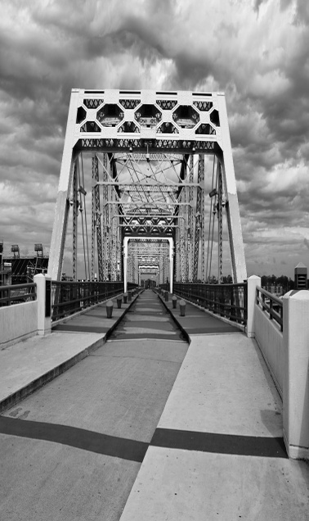
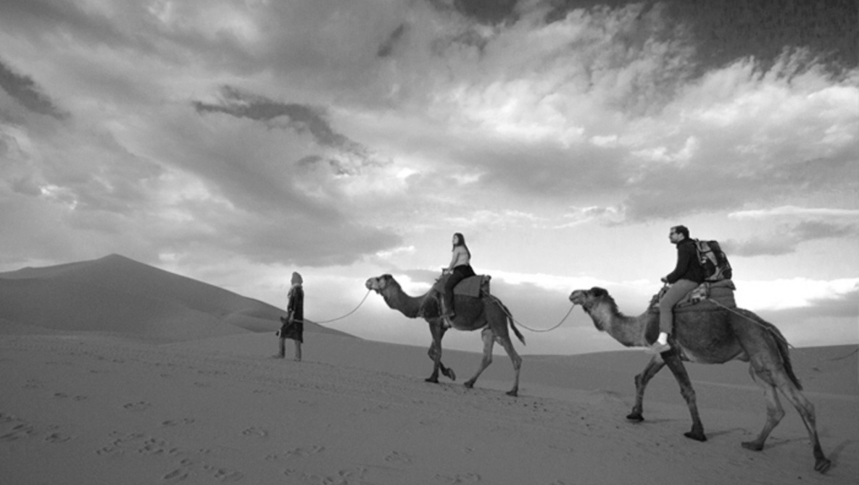
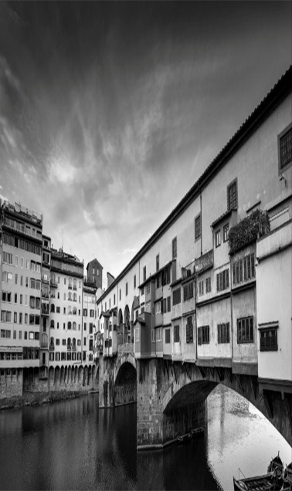


WRITE
YOUR
TITLE
Memories flashed across my mind as I came across the
first photo of myself as a little baby. Nostalgia took me
to the depths of past.

Slide 7
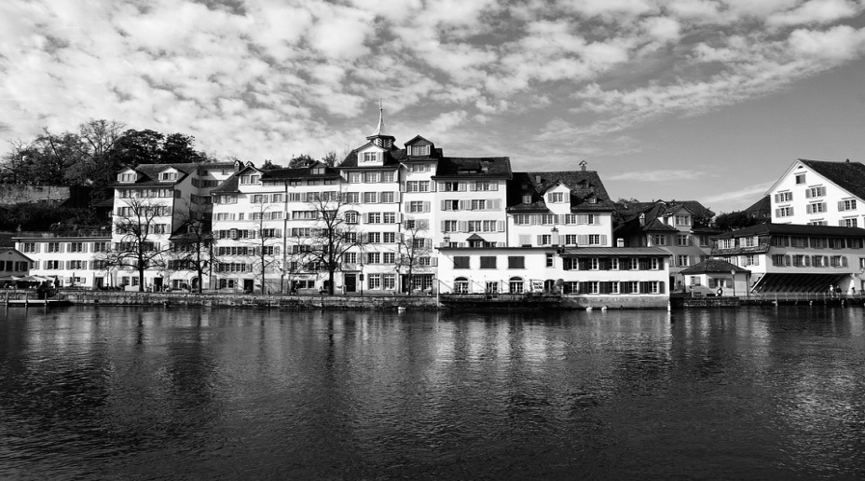
2
CONTENT 2
Memories flashed across my mind as I came across the
first photo of myself as a little baby. Nostalgia took me
to the depths of past.

Slide 8

SUBTITLE
Memories flashed across my mind as I came
across the first photo of myself as a little baby.
Nostalgia took me to the depths of past.

Slide 9
ADD YOUR TITLE
ADD YOUR TITLE
2019
Memories flashed across my mind as I came across the first photo of myself as a little baby. Nostalgia took me to the depths of past.
2018

Slide 10
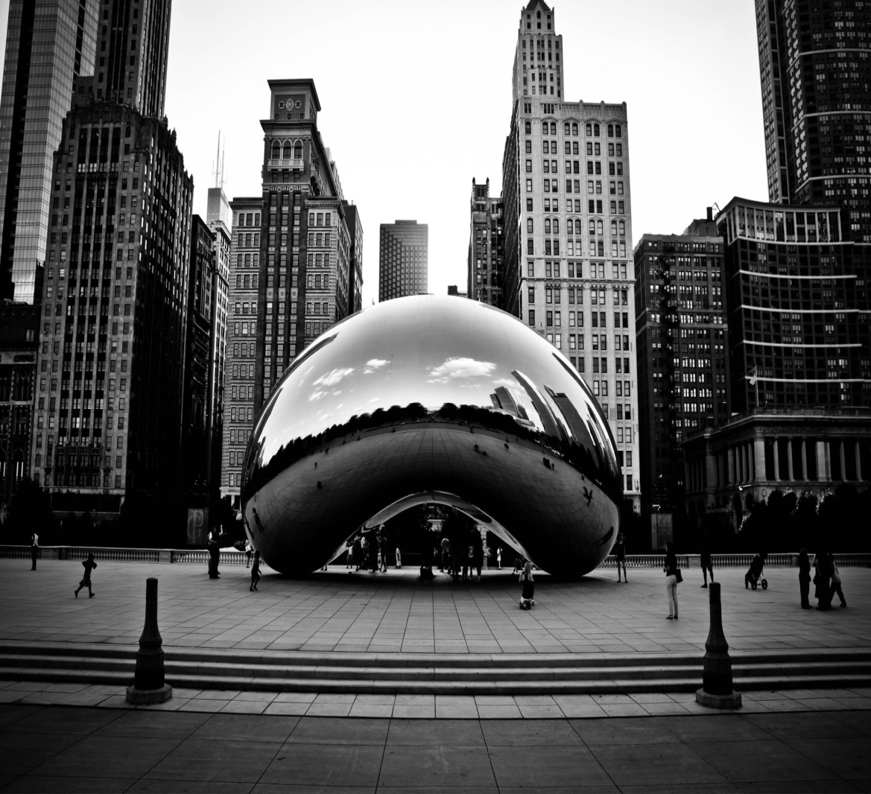
SUBTITLE
Memories flashed across my mind as I
came across the first photo of myself as
a little baby. Nostalgia took me to the
depths of past.

Slide 11
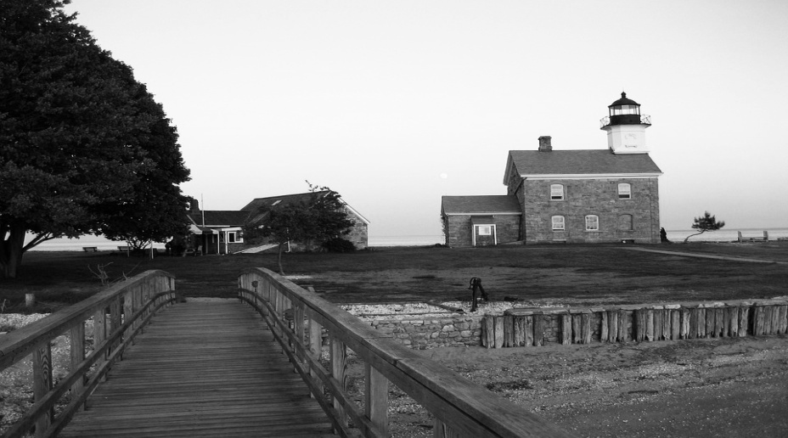
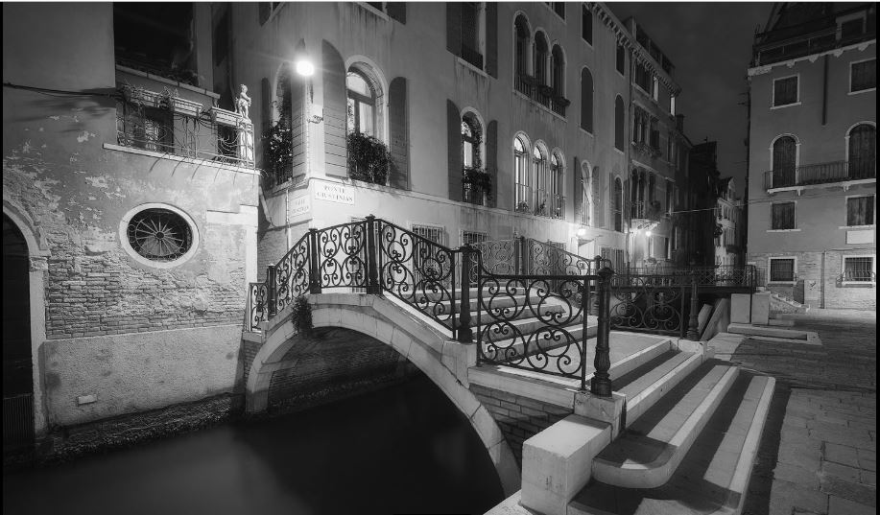
1
CONTENT 1
Memories flashed across my mind as I came across the
first photo of myself as a little baby. Nostalgia took me
to the depths of past.

Slide 12
SUBTITLE
75+
85+
55+
65+
Memories flashed across my mind as I came across the first photo of
myself as a little baby. Nostalgia took me to the depths of past.

Slide 13
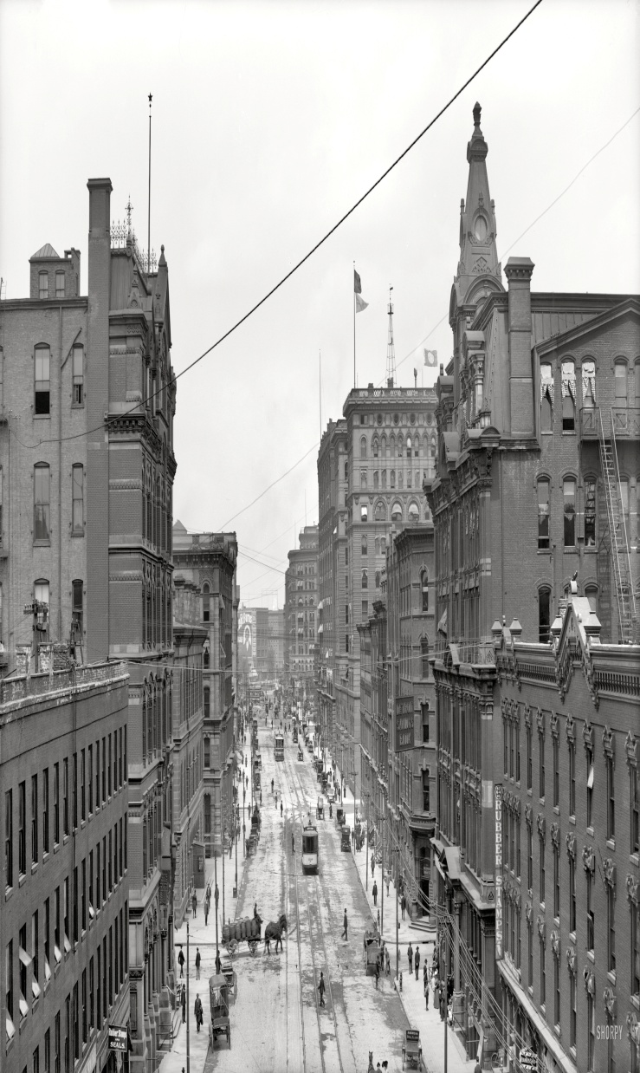
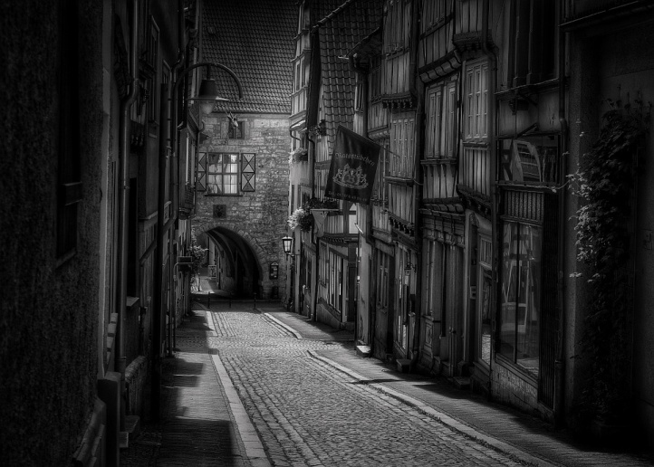

SUBTITLE
Nostalgia took me to the depths of past.

Slide 14
SUBTITLE
ADD YOUR TITLE
ADD YOUR TITLE
ADD YOUR TITLE
Nostalgia took me to the
depths of past.
Nostalgia took me to the
depths of past.
Nostalgia took me to the
depths of past.

Slide 15
1
CONTENT 1
Memories flashed across my mind as I came across the
first photo of myself as a little baby. Nostalgia took me
to the depths of past.

Slide 16

SUBTITLE
ADD YOUR TITLE
Nostalgia took me to the depths of past.
ADD YOUR TITLE
Nostalgia took me to the depths of past.
ADD YOUR TITLE
Nostalgia took me to the depths of past.

Slide 17


SUBTITLE
Memories flashed across my mind as I came across the
first photo of myself as a little baby. Nostalgia took me
to the depths of past.

Slide 18

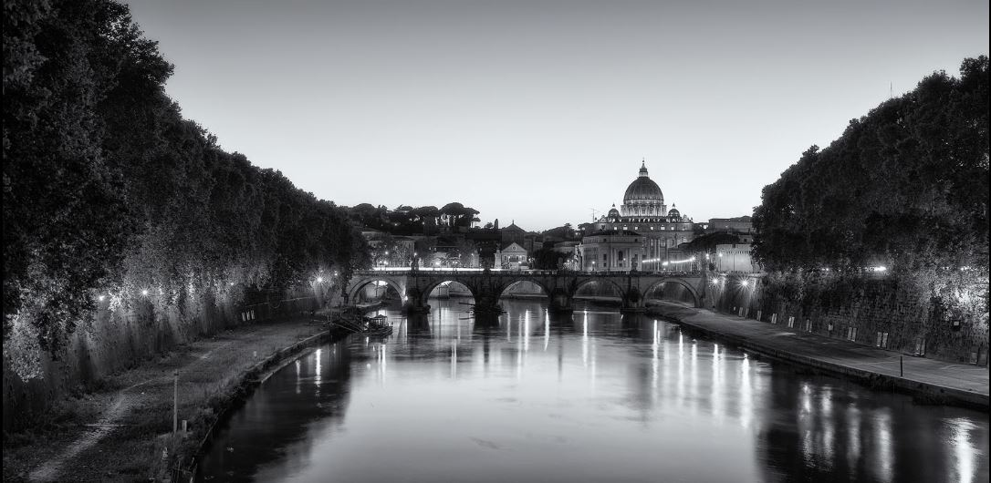
SUBTITLE
ADD YOUR TITLE
ADD YOUR TITLE
Nostalgia took me to the
depths of past.
Nostalgia took me to the
depths of past.
ADD YOUR TITLE
ADD YOUR TITLE
Nostalgia took me to the
depths of past.
Nostalgia took me to the
depths of past.

Slide 19
5
CONTENT 5
Memories flashed across my mind as I came across the
first photo of myself as a little baby. Nostalgia took me
to the depths of past.

Slide 20
SUBTITLE
Nostalgia took me to the
depths of past.
75%
ADD YOUR TITLE
45%
Nostalgia took me to the
depths of past.

Slide 21
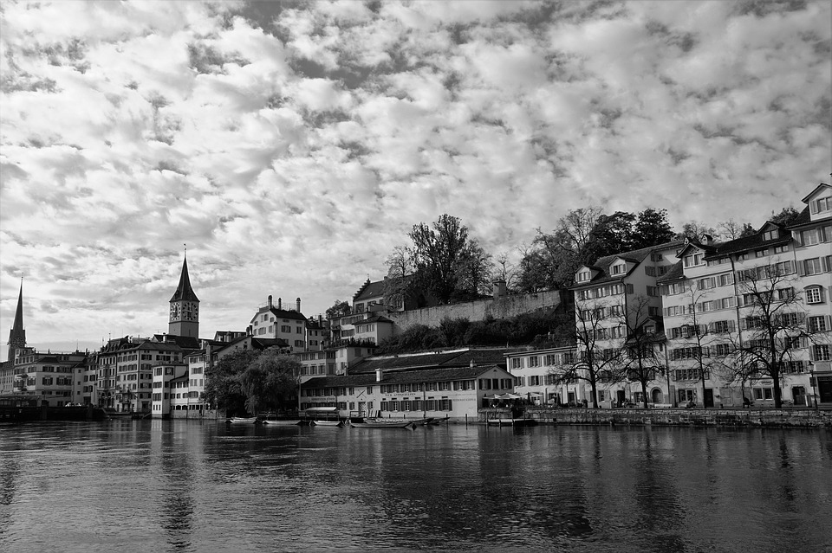
SUBTITLE
Memories flashed across my mind as I
came across the first photo of myself as
a little baby. Nostalgia took me to the
depths of past.

Slide 22
SUBTITLE
ADD YOUR TITLE
ADD YOUR TITLE
Nostalgia took me to the depths
of past.
Nostalgia took me to the depths
of past.
ADD YOUR TITLE
Nostalgia took me to the depths
of past.

Slide 23
Nostalgia took me
to the depths of past.
SUBTITLE

